Slide 1


Team 61: HARD
Bi-Weekly Update 1 William Jachimiak, Jean Jacques Chirat,
Preston Bowyer, Aiden George
Sponsor: Professor Arya Menon
Notes:
Michelle

Slide 2

Project Summary
Our project seeks to solve the problem of monitoring fall injury prone individuals in assisted-care through the following implementation:
Collection of vertical position & velocity data (minimally invasive) using mmWave radar
Stream the data to Raspberry Pi to be processed by ML detection algorithm
Pi communicates positive detection result over WiFi network to Firebase cloud
Firebase interfaces with Android app to notify assisted-care workers if fall event occurs
Notes:
Kyle

Slide 3
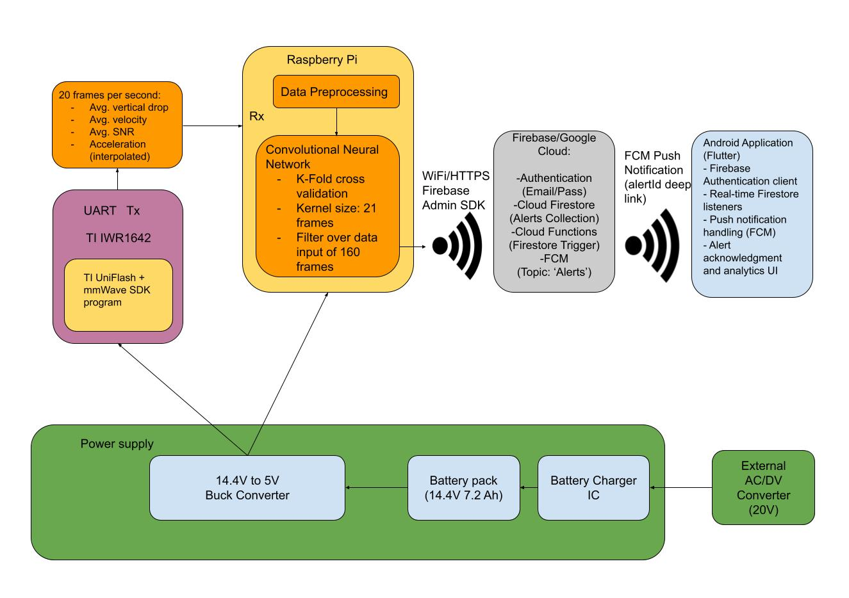
Project/Subsystem Overview
Notes:
Eric

Slide 4
Major Project Changes for 404
Change from ESP32 to a Raspberry Pi
Changes to the power subsystem in the buck converter and battery charging
Notes:
Eric

Slide 5
MCU/SBC
William Jachimiak
Accomplishments since 403: 15 hrs of effort | Ongoing progress/problems and plans until the next presentation
Moved over ESP32 work to the raspberry pi Made a sliding queue system that takes in frames to be read by machine learning | Integrate with machine learning subsystem Integrate with App through the cloud

Slide 6
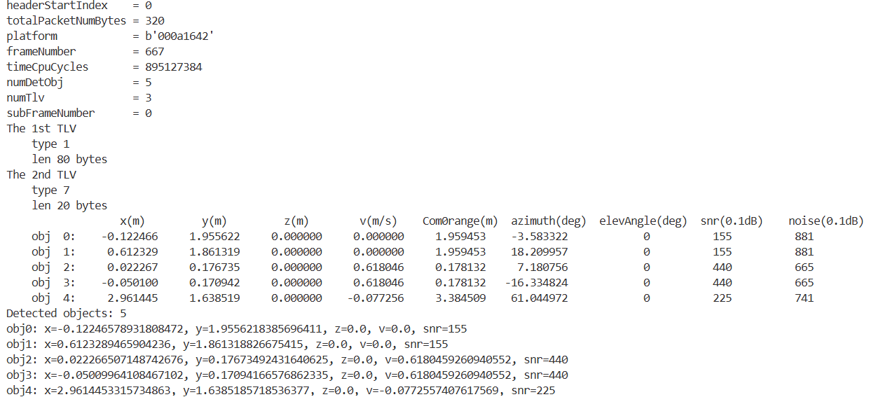
Parsed Frame from the Radar

Slide 7
Machine Learning
Jean Jacques Chirat
Accomplishments since 403 12 hrs of effort | Ongoing progress/problems and plans until the next presentation
Achieved high rate of detection accuracy (>90% in most test sets) Added more edge case data (running, jumping, sitting, etc. at least 10 datasets each) Conversion into ONNX framework (better for limited computational resources) Optimized some methods used in the training process | Integrate data processing with the MCU code to run on the Pi Verify that the model works correctly using a dummy input Work on how to synchronize real-time data with signal processing to ensure detection is done in a timely manner, and without losing information

Slide 8
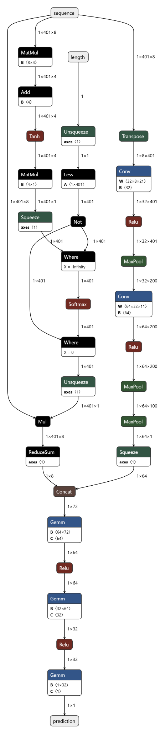
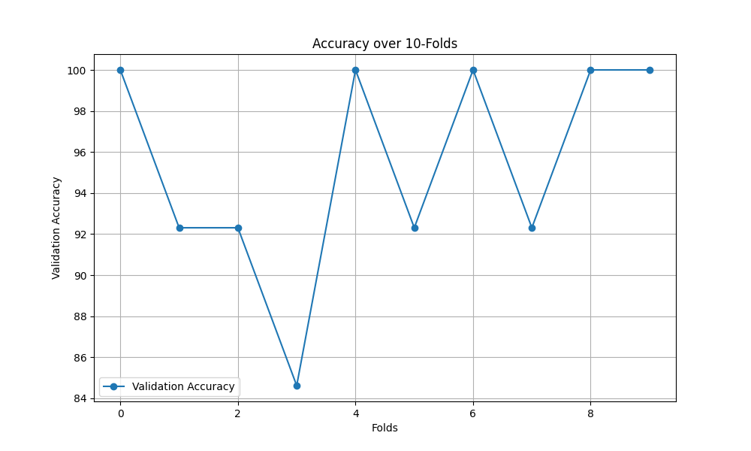
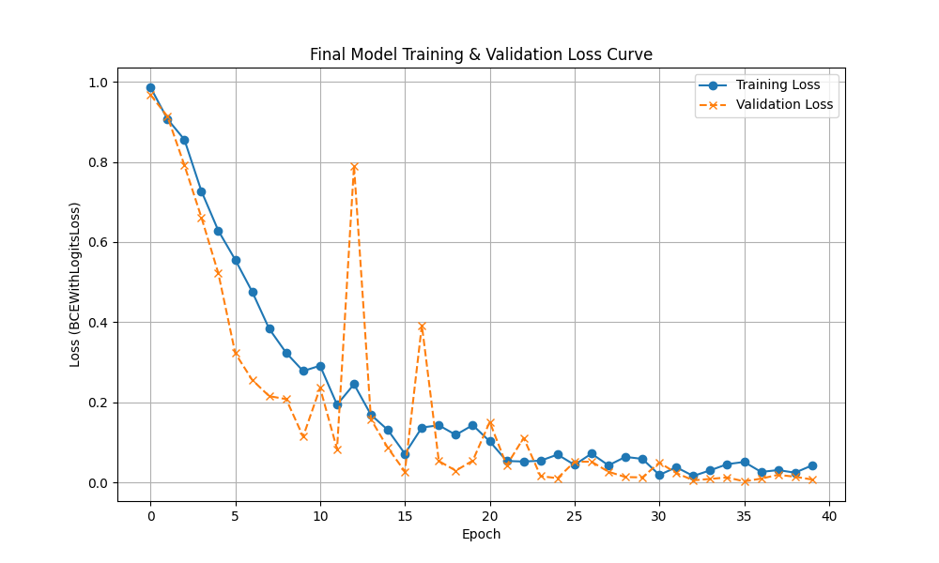
Machine Learning
Jean Jacques Chirat
Current performance:
Training accuracy: 99.96%
Validation accuracy: 96.15% +/- 5.16%
Test accuracy: 92.73%
False positive rate: 6.9%
False negative rate: 1.8%
10-fold iteration accuracy
Visualization of model structure
Training & validation accuracy

Slide 9
Power Supply
Aiden George
Accomplishments since 403 25 hrs of effort | Ongoing progress/problems and plans until the next presentation
New power supply design has been designed to accommodate higher voltage and current requirements from new MCU Battery and charging circuit modified to a higher voltage from 7.2V to 14.4V to allow charging under max load Previous voltage regulators replaced with a single 5V 10A regulator | Simulate new voltage regulator using PSPICE to validate design under load Finalize updated PCB design Order parts and PCB

Slide 10
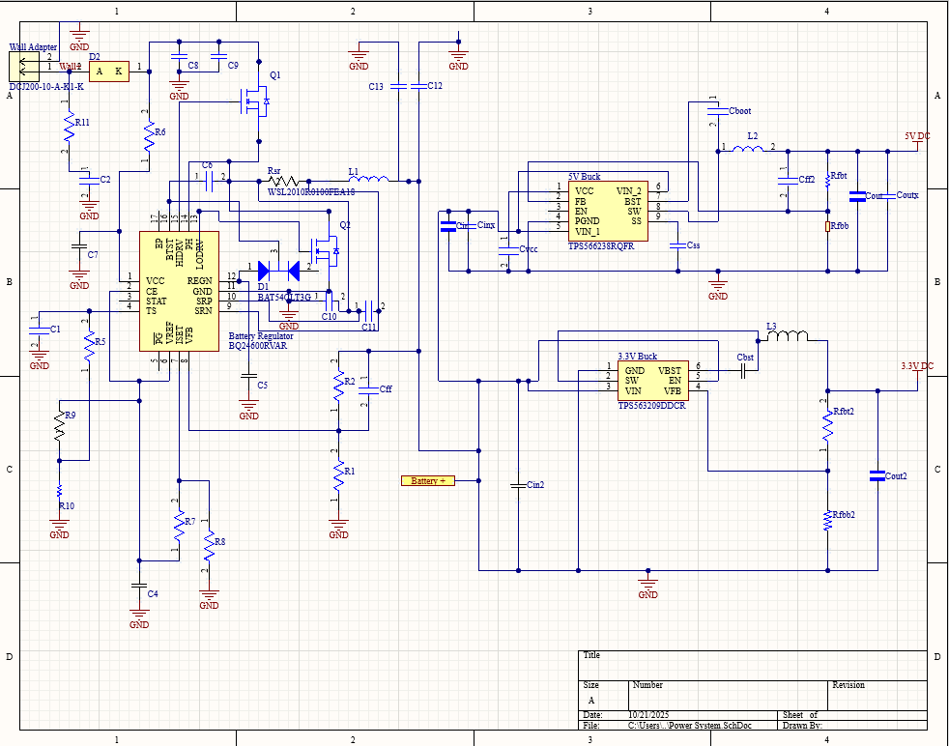
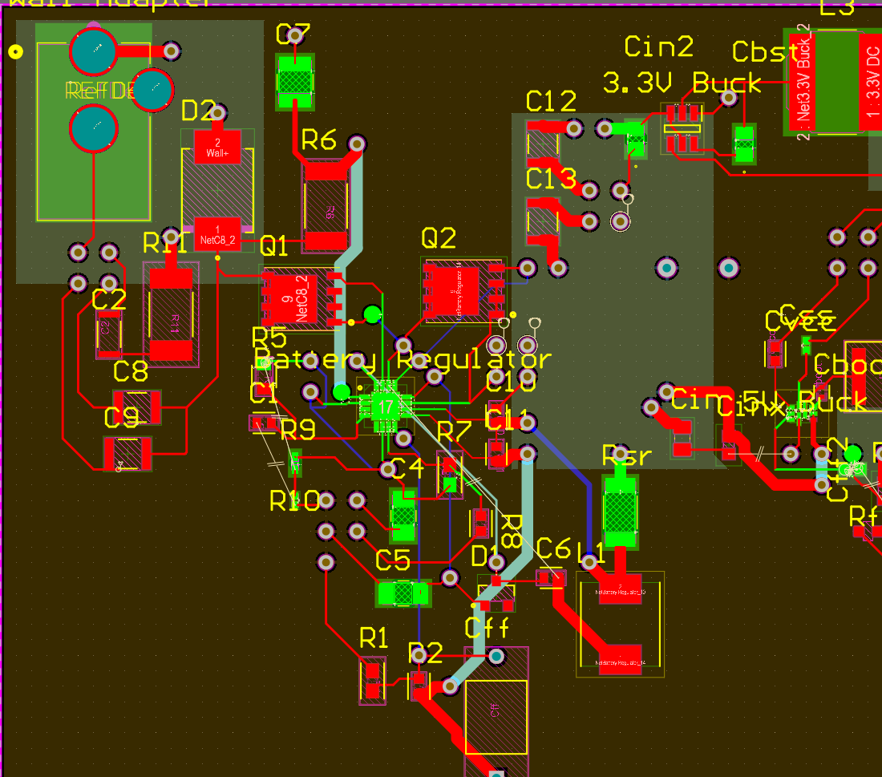
Power Supply
Previous Power Supply
Previous PCB

Slide 11
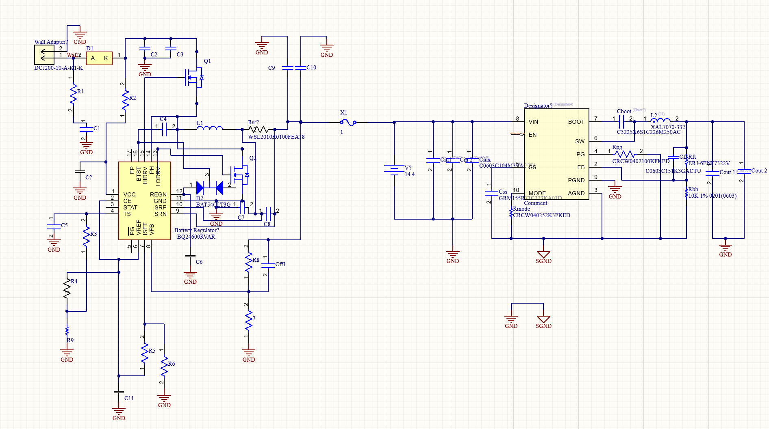
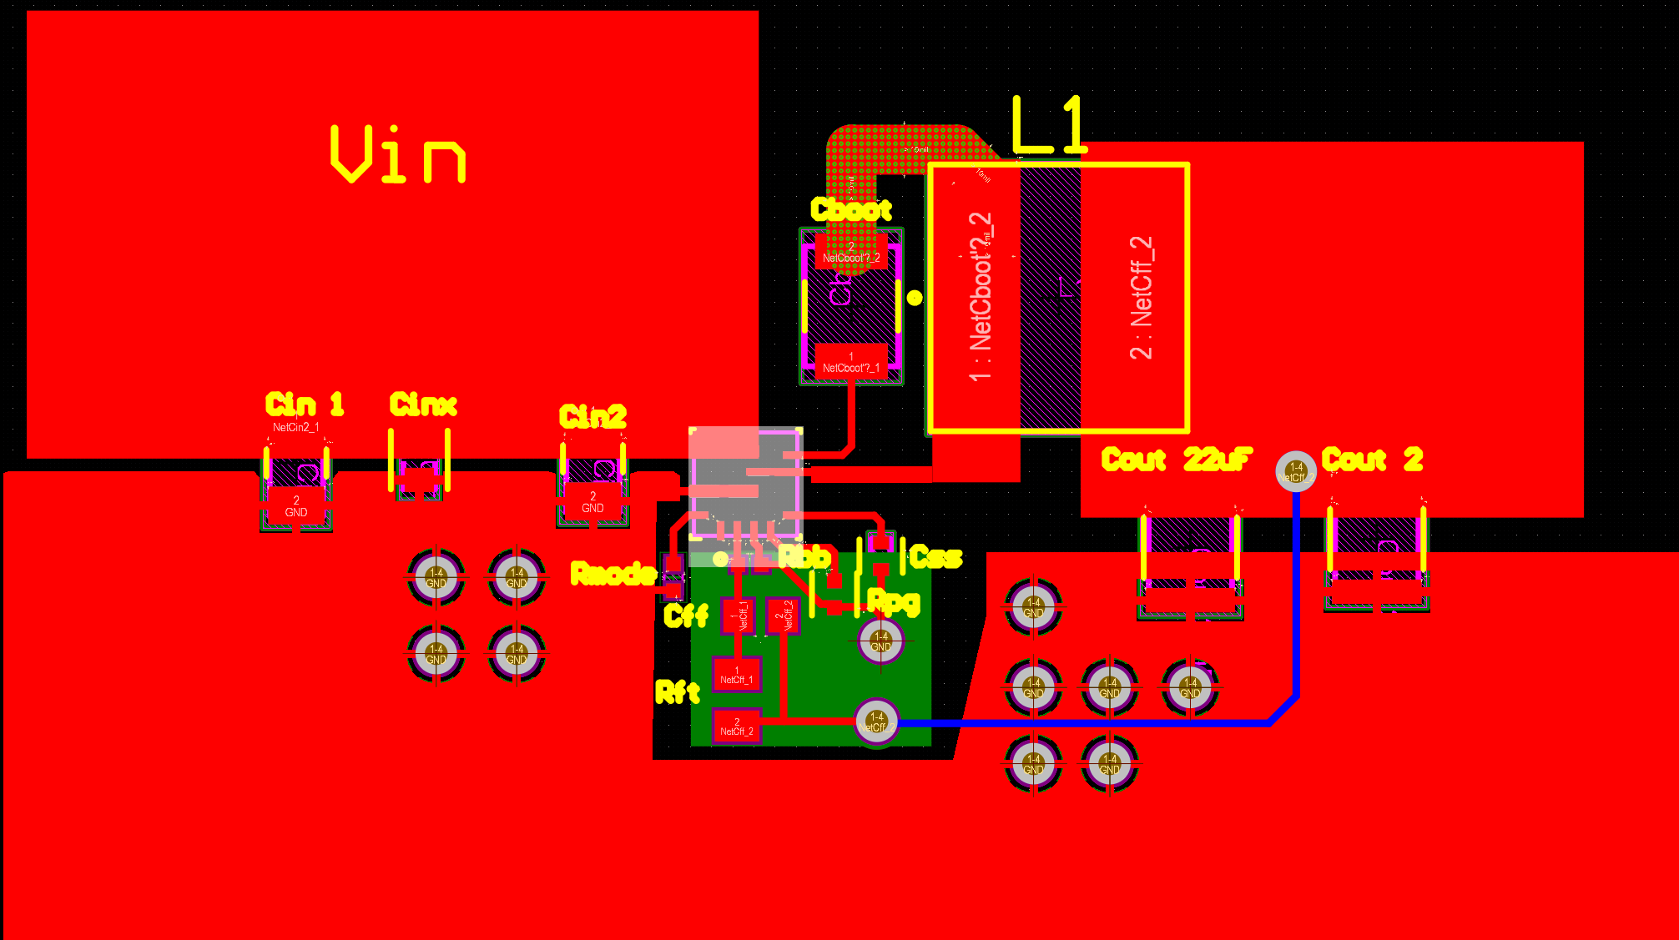
Power Supply
Aiden George
Updated Power Supply
New Voltage Regulator

Slide 12
End User App
Preston Bowyer
Accomplishments since 403 15 hrs of effort | Ongoing progress/problems and plans until the next presentation
Deployed Firestore-triggered Cloud Function to send push alerts via FCM. Integrated topic-based notifications for all authenticated app users. Implemented idempotent alert notification handling in Firestore. Standardized alert schema for acknowledgment and timing analytics. | Assist with Raspberry Pi to Firebase communication for publishing alert documents. Verify end-to-end alert flow using Raspberry Pi–generated Firestore events. Measure alert acknowledgment latency from creation to user response.

Slide 13
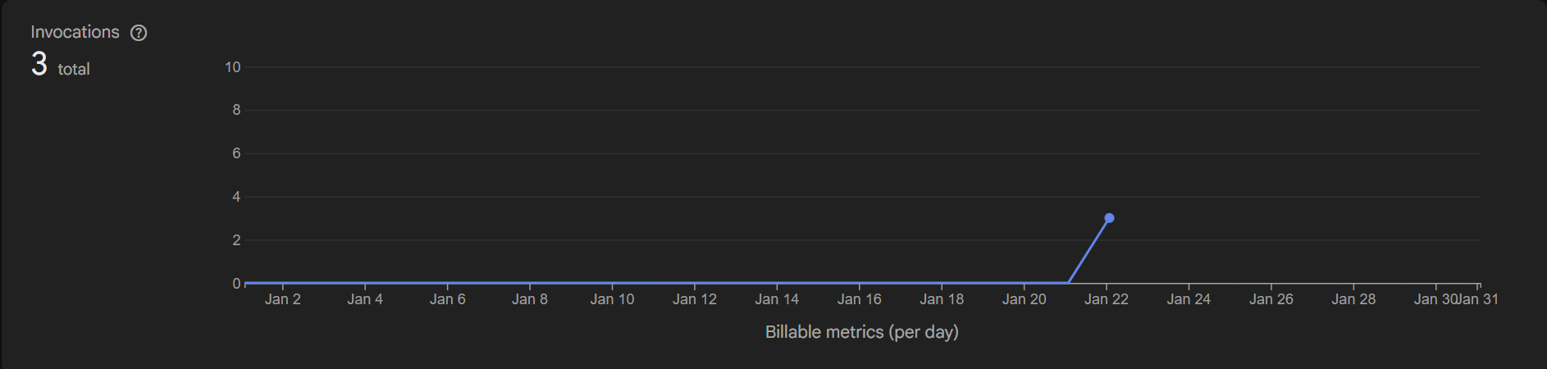
End User App
Preston Bowyer
Cloud function execution log

Slide 14
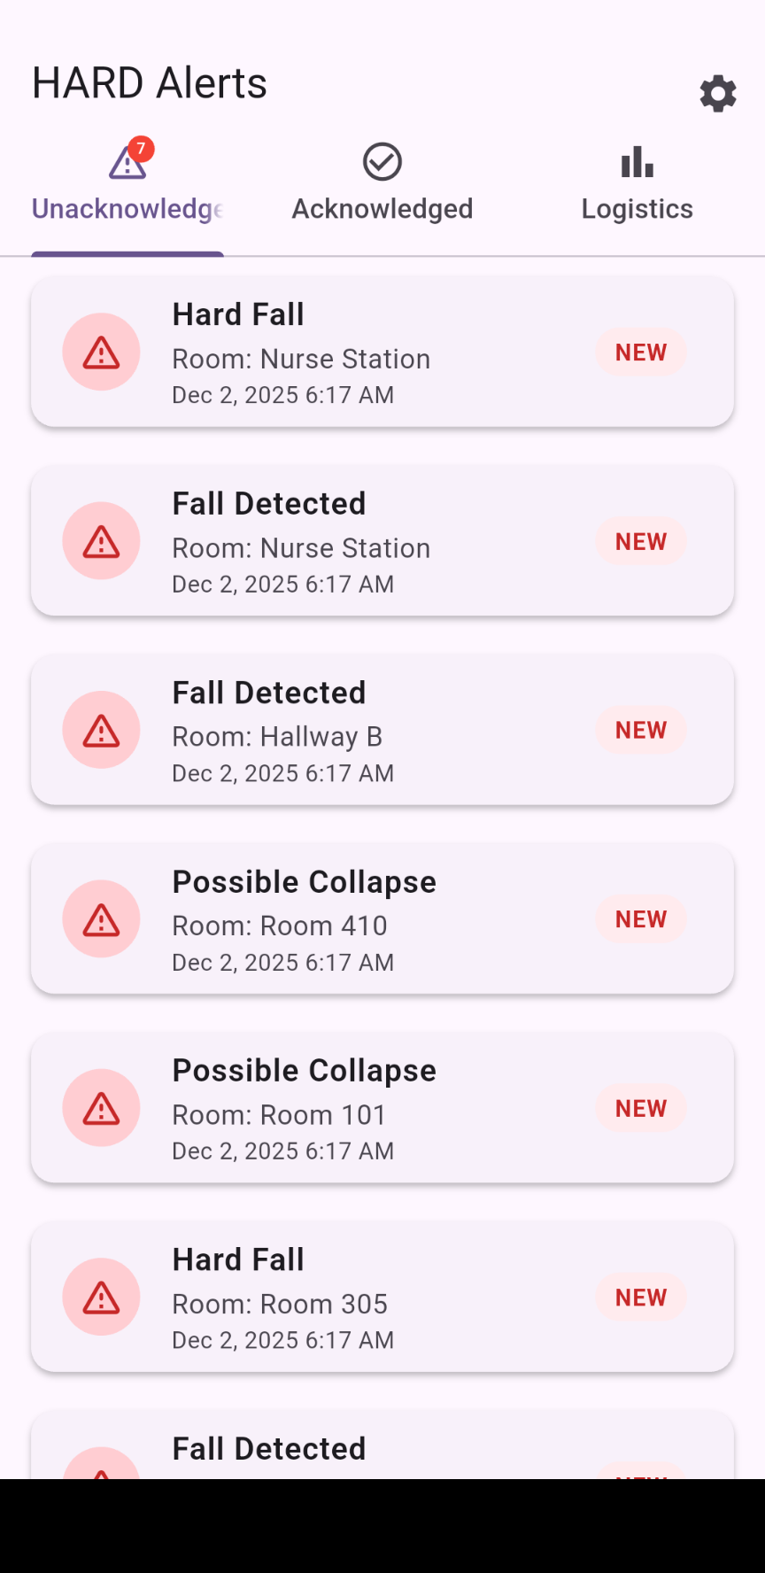
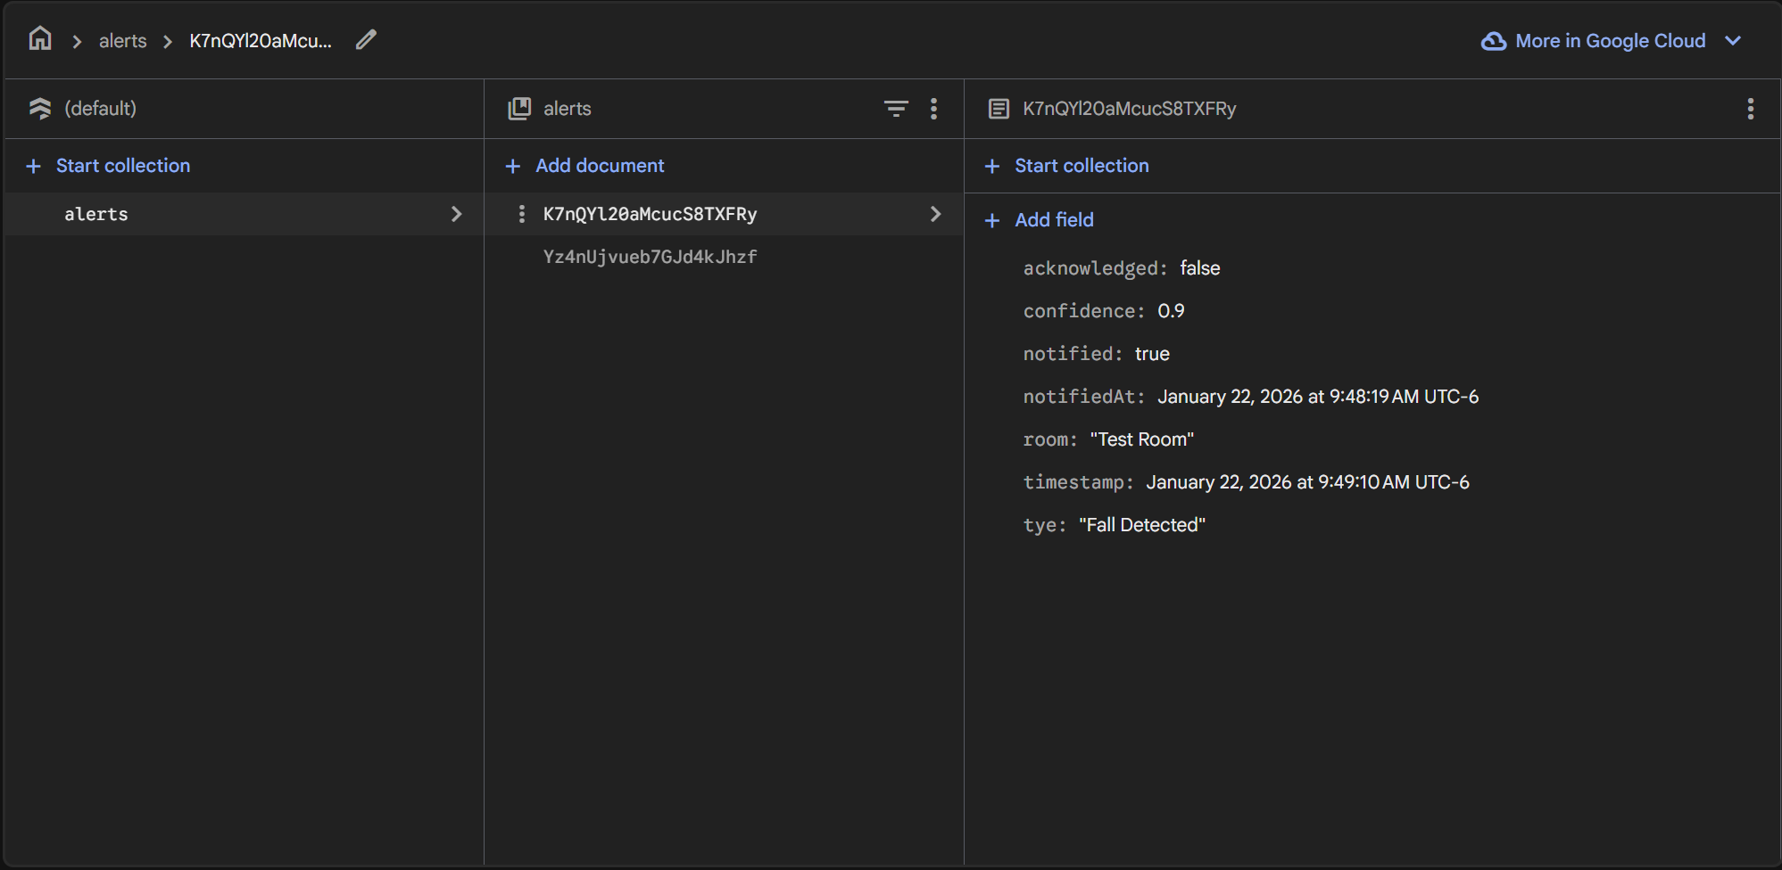
End User App
Preston Bowyer
Firestore alert document and Unacknowledged page of app

Slide 15
Parts Ordering Status
Only the PCB and parts and connectors need to be ordered
All parts should be ordered by February 14 and received within 2 weeks of this date
Notes:
Michelle

Slide 16
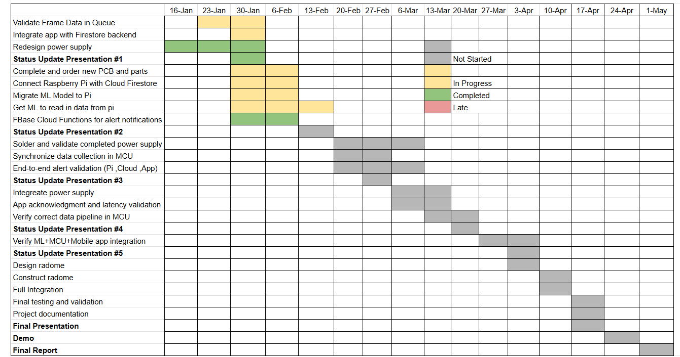
Execution & Plan
Notes:
Michelle

Slide 17
Validation Plan
MCU Subsystem | Validation Criteria | Definition | Progress
T1 | Radar Configuration | Radar will be succesfully configured 100% of the time. | Pass
T2 | Zero Read Dropped Frames | Be able to read in data from the radar with 0% frame drop | Pass
T3 | Frame Selection | Drop any bad or incomplete frames from read with an accuracy of 100% | Pass
T4 | App Connection | Be able to send out a JSON type alert to firebase 100% of the time. | In Progress
T5 | Sliding Queue Dropped Frames | The sliding queue will be able to continually take in new frames and drop old frames without missing frames between and not failing to pass frames to the ML subsystem | In Progress

Slide 18
Validation Plan
Machine Learning Subsystem | Validation Criteria | Definition | Progress
T1 | False Positive Rate | A non-fall event which is classified as a fall event as a ratio of all non-fall cases | 2.99%
T2 | False Negative Rate | A fall event which is classified as a non-fall event as a ratio of all fall cases | 2.56%
T3 | Train & Test Dataset Size | The combined number of datasets used for model training and datasets for model simulation | 164
T4 | Fall Positive Dataset | Number of datasets which serve as ground truth for falling scenario or '1' | 60
T5 | Fall Negative Dataset | Number of datasets which serve as ground truth for non-falling scenario | 104
T6 | Edge case handling | Model must account for motion patterns that do not conform to majority of fall or non-fall patterns | 20

Slide 19
Validation Plan
Machine Learning Subsystem | Validation Criteria | Definition | Progress
T7 | Confuser Rejection | Combined total of false positive and false negative classifications as a ratio of total test cases | 2.83%
T8 | Noise handling | Model must account for noise that may be present in real-life residences | Added Gaussian noise of magnitude 0.1
T9 | Detection delay | Model must be able to completely process any falling motion data within a reliable timeframe | TBD in integration
T10 | Computation Speed | Real-time data must be converted to .json, preprocessed, and classified before the processing of the following data batch. A standard data batch will be 160 frames, so a dataset of this length will be used to set the benchmark. | 0.313 s

Slide 20
Validation Plan
Power Supply Subsystem | Validation Criteria | Definition
T1 | Output Voltage within range | Output voltage should be within +- 0.1V of the expected output with both power supplied from the batteries and the AC/DC converter
T2 | Max current load achieved | Output current when connected to a load resistor is able to achive 5A
T3 | Minimum Runntime Achived | A minimum runntime of 4 hours when not charging achived when integrated with the main system achived
T4 | Battery charging voltage | Battery Charger voltage should be within +- 0.1V of the expected output
T5 | Max battery charging current | A battery charging current of 2A achived
T6 | Stable charger disconent | When the device is unplugged a spike in DC voltage of no more than +- 0.5V is seen

Slide 21
Validation Plan
Mobile App Subsystem | Validation Criteria | Definition | Progress
T1 | Firebase Auth login | Valid users authenticate successfully; unauthenticated users are blocked from app content. | Pass
T2 | Firestore alert publish | Raspberry Pi writes alert document to production alerts collection using defined schema. | In Progress
T3 | Firestore trigger execution | Cloud Function executes on alert creation and logs successful invocation. | Pass
T4 | FCM push delivery | Push notification delivered to device for each new alert document. | Pass
T5 | Active app alert update | New alerts appear in Unacknowledged list in real time without manual refresh. | Pass
T6 | Background / killed app | Notification delivered; tapping notification opens correct alert detail screen. | In Progress

Slide 22
Validation Plan
Mobile App Subsystem | Validation Criteria | Definition | Progress
T7 | Duplicate prevention | Each alert document generates exactly one notification (no duplicates). | In Progress
T8 | User acknowledgment flow | App updates acknowledged, acknowledgedBy, and acknowledgedAt fields correctly in Firestore. | Pass
T9 | End-to-end timing | Alert reaches app within ≤ 2 seconds typical, ≤ 5 seconds worst-case. | In Progress
T10 | Burst alert handling | System handles ≥50 alerts without missed notifications or crashes. | In Progress

Slide 23
Thank you for listening!
Q & A

Slide 24
Thank you for listening!
Q & A

